Slide 1
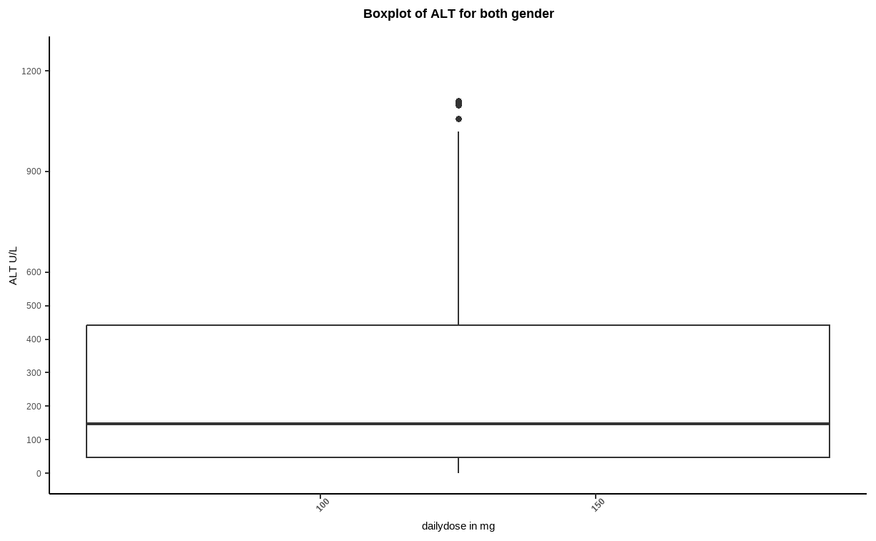
1st graph Boxplot of ALT for both gender

Slide 2
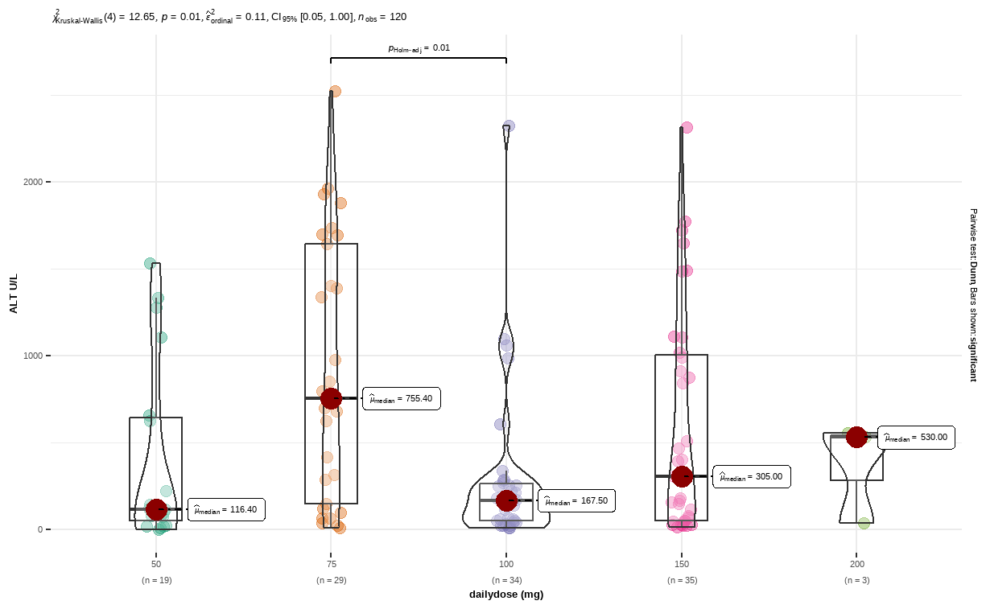
2nd graph alt with daily dose

Slide 3
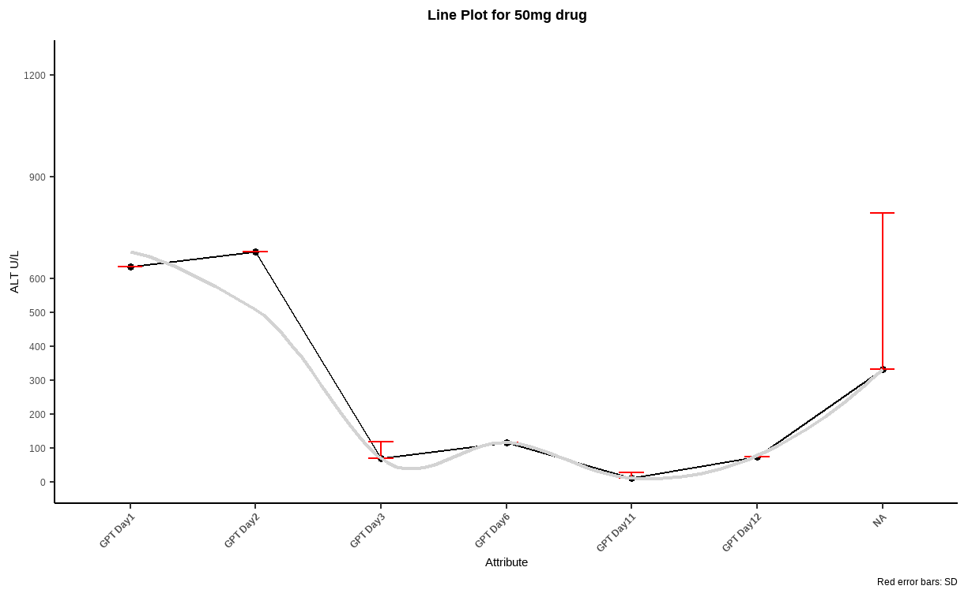
3rd graph line plot for 50mg drug

